Slide 1


NBA DATA ANALYSIS
MISY-225 Group 24
Boyue Yang, Haoling Shi

Slide 2
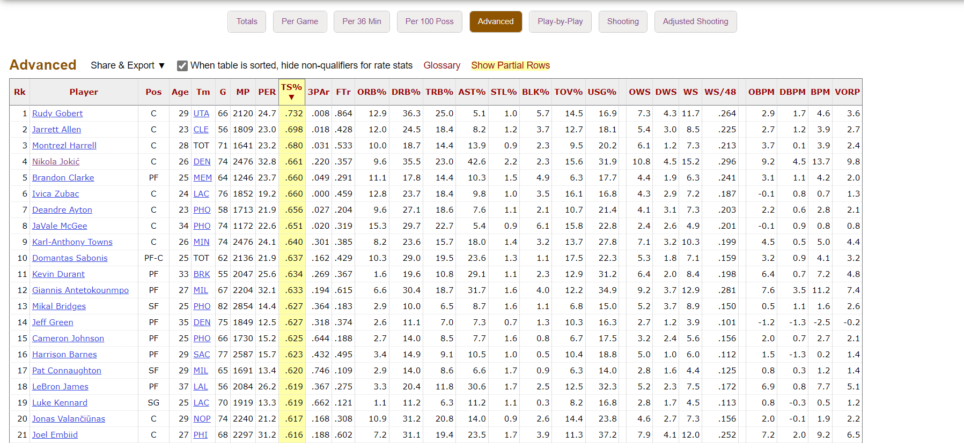
Data set description
Data source:
https://www.basketball-reference.com/leagues/NBA_2022_totals.html

Slide 3
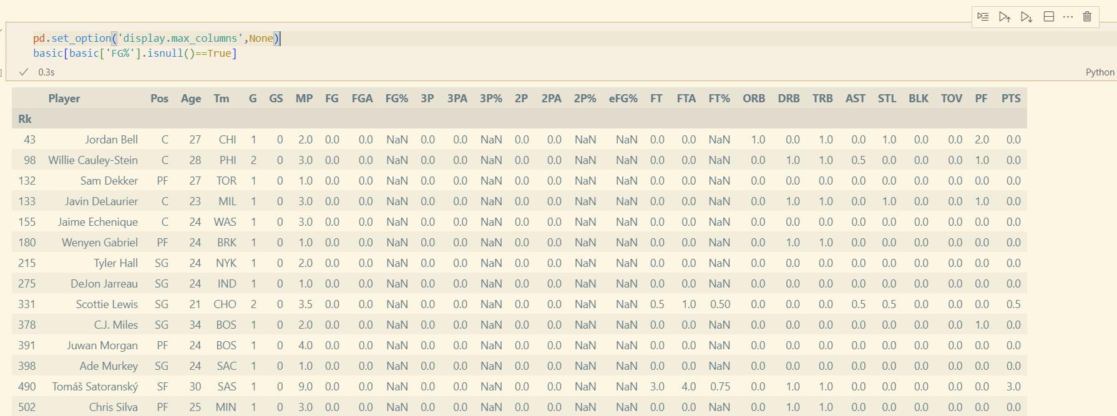
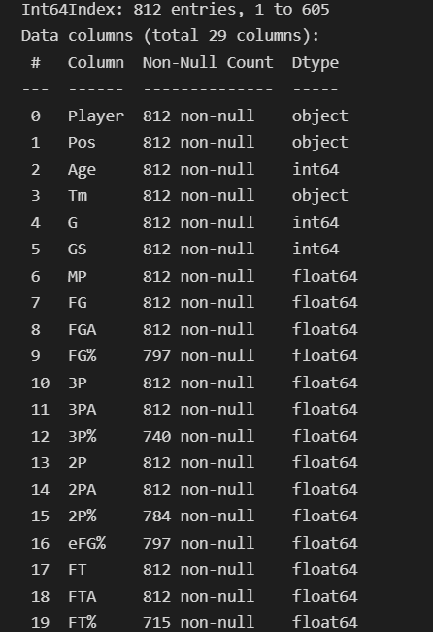
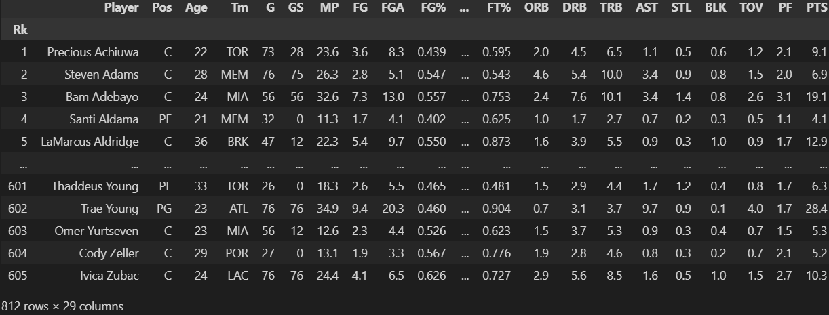
Data set description

Slide 4
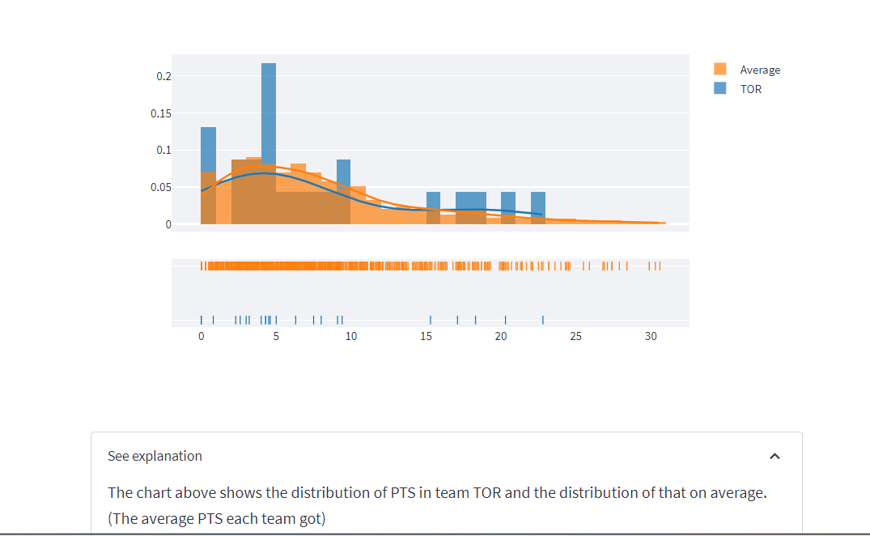
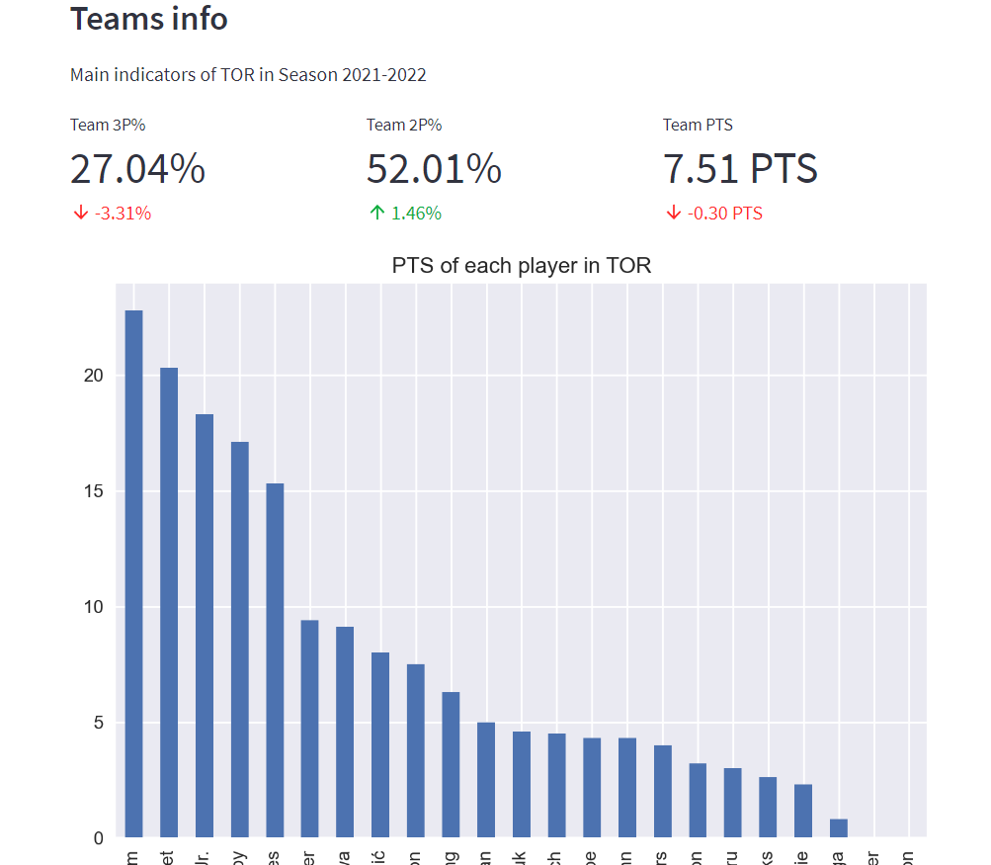
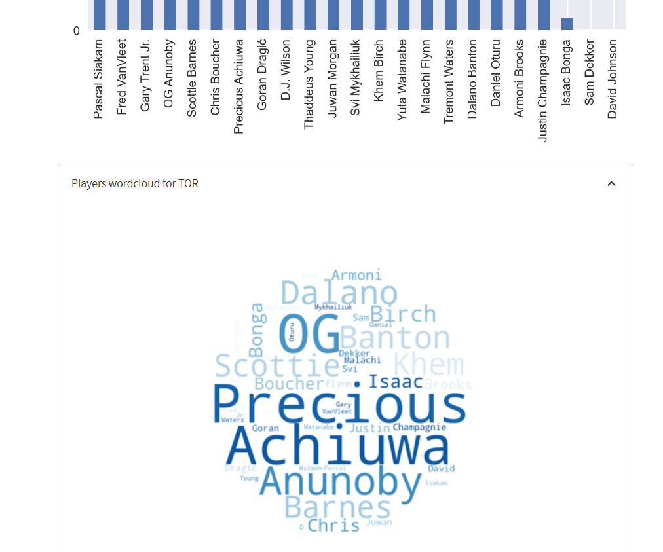
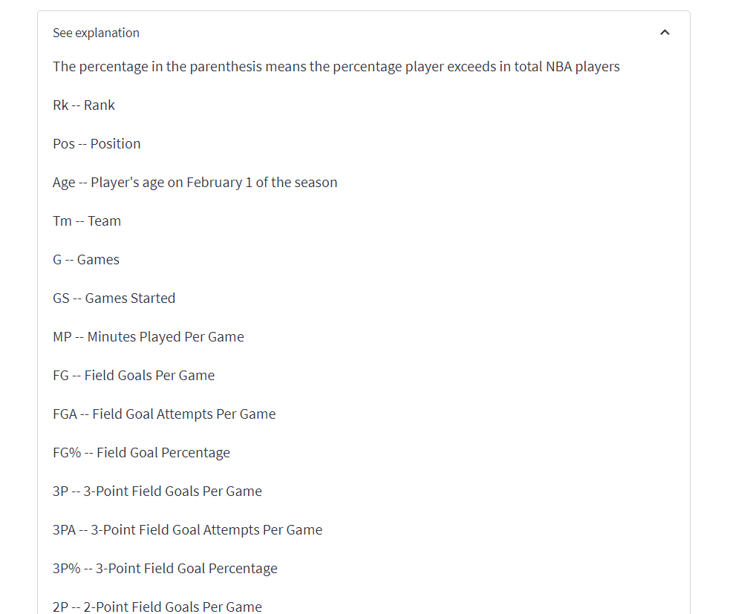
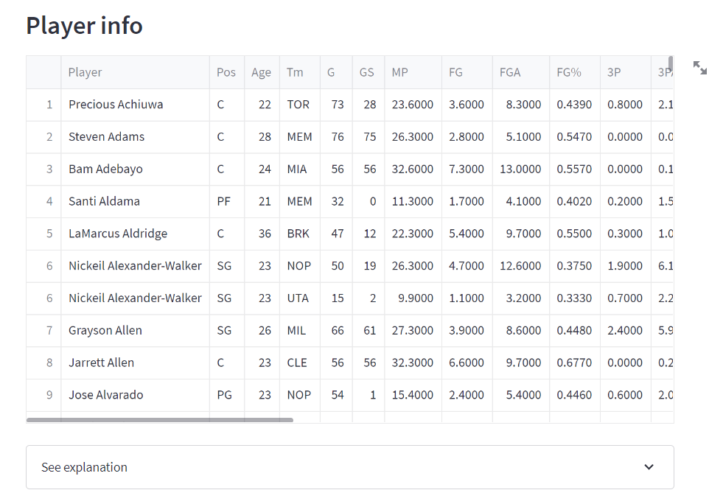
NBA Data Analysis App
3 parts:
1. Player Information
2. Team Information
3. subdivisional analysis for some stats

Slide 5
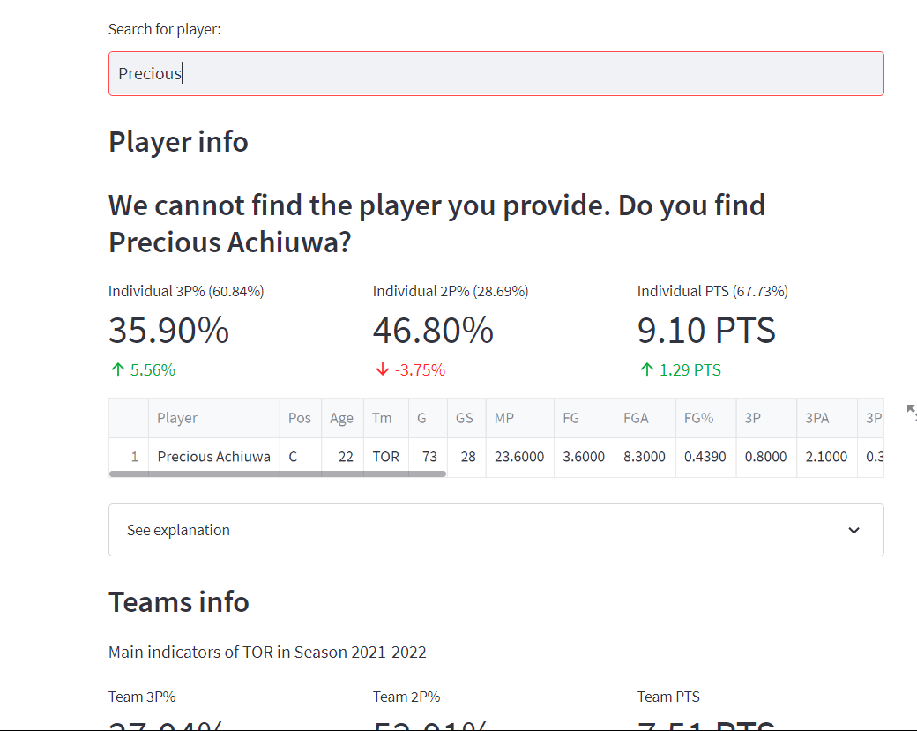
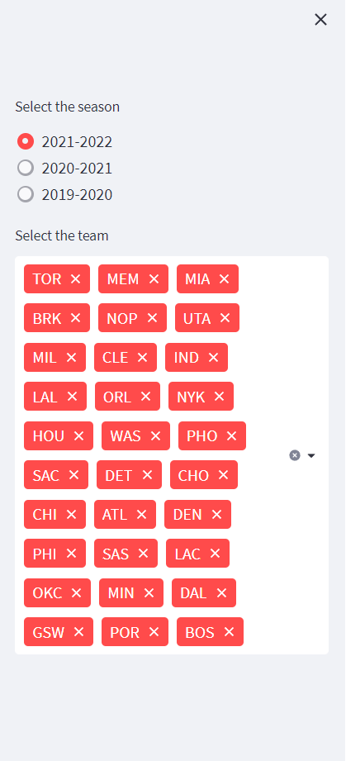
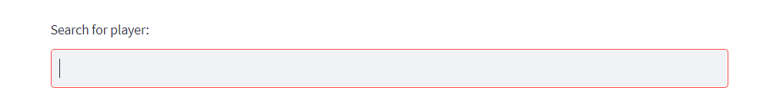
Filter data and display main indicators

Slide 6
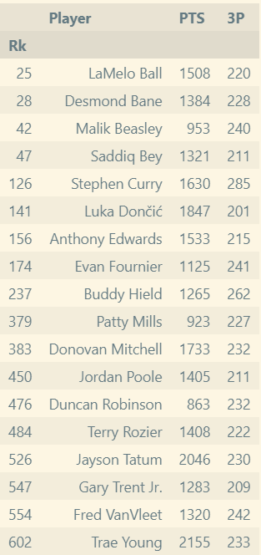
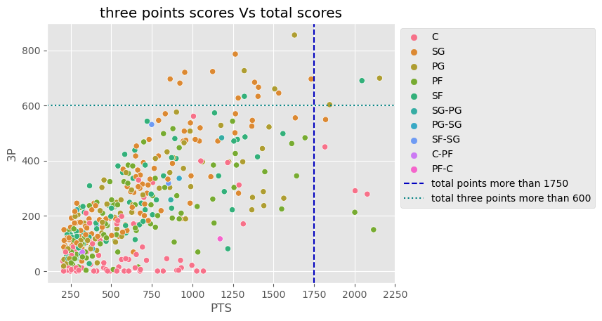
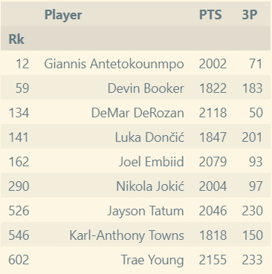
subdivisional analysis for some stats

Slide 7
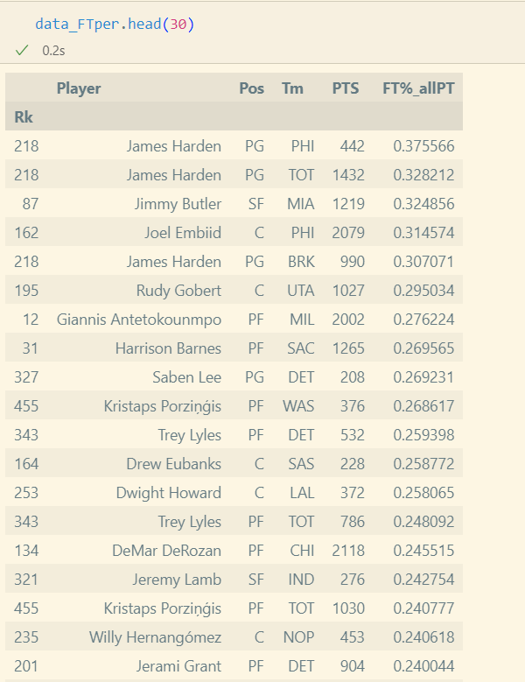
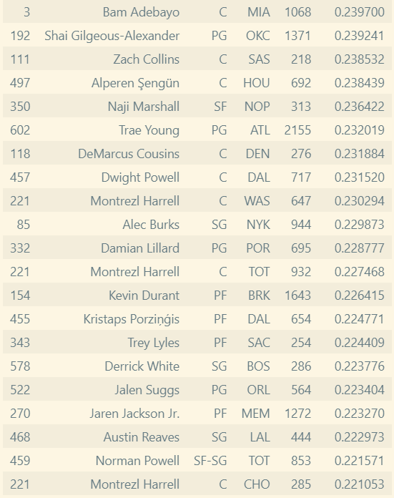
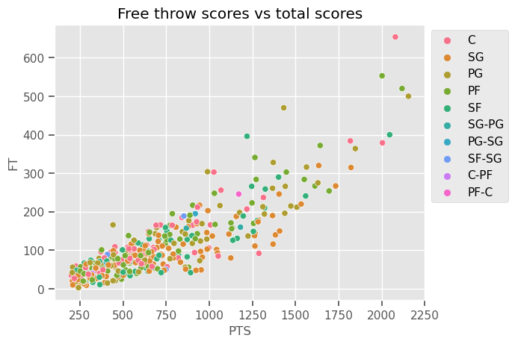
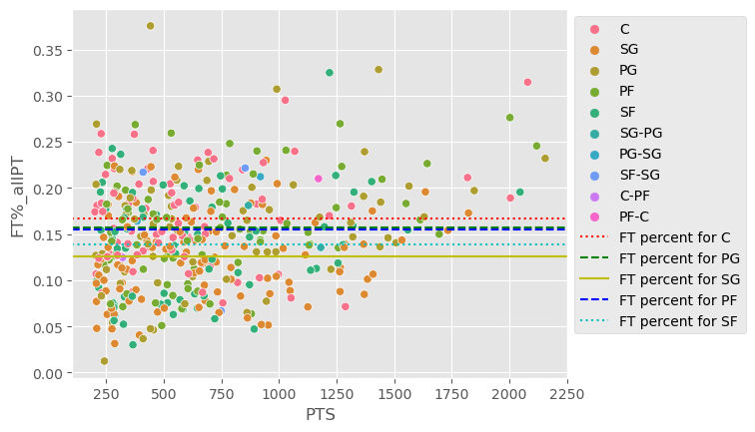
subdivisional analysis for some stats
Conclusions
There is no strong relationship between player's total points and their free throw scores percentage.
The Center players rely on free throw more that other position.

Slide 8
Thanks for listening
MISY-225 Group 24 Boyue Yang, Haoling Shi

